Slide 1
TRANSPORT MANAGEMENT SYSTEM

Slide 2
TABLE NAME: ADMIN
FIELD | DATA TYPE | SIZE | CONSTRAINT
admin id | Int | 10 | Primary key
Username | varchar | 20 | Not null
Password | varchar | 20 | Not null

Slide 3
TABLE NAME: BUS
FIELD | DATA TYPE | SIZE | CONSTRAINT
Bus id | Int | 10 | Primary key
Bus name | Varchar | 20 | Not null
Register number | Varchar | 20 | Not null
No of seats | Int | 10 | Not null
Bus type | varchar | 10 | Not null

Slide 4
TABLE NAME: DRIVER
FIELD | DATA TYPE | SIZE | CONSTRAINT
Driver id | Int | 10 | Primary key
Driver name | Varchar | 20 | Not null
Mobile number | Int | 10 | Not null
Address | varchar | 30 | Not null
License number | varchar | 10 | Not null
Salary | Int | 5 | Not null
Id proof | varchar | 10 | Not null
Id proof number | varchar | 10 | Not null

Slide 5
TABLE NAME: GOODS
FIELD | DATA TYPE | SIZE | CONSTRAINT
Goods id | Int | 10 | Primary key
Bus id | Int | 10 | Foreign key
Driver id | Int | 10 | Foreign key
From | varchar | 20 | Not null
To | varchar | 20 | Not null
Goods name | varchar | 20 | Not null
Total amount | Int | 10 | Not null

Slide 6
TABLE NAME: BILLING
FIELD | DATA TYPE | SIZE | CONSTRAINT
billing id | Int | 10 | Primary key
Driver id | Int | 10 | Foreign key
Bus id | Int | 10 | Foreign key
Goods id | Int | 10 | Foreign key
Total amount | Int | 5 | Not null
Date | Date | 10 | Not null

Slide 7
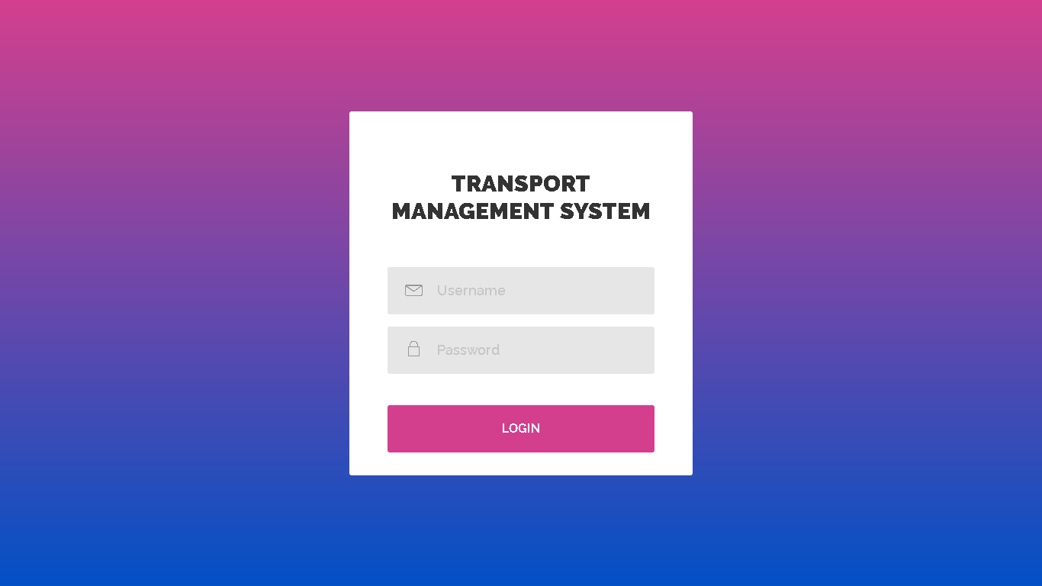

Slide 8
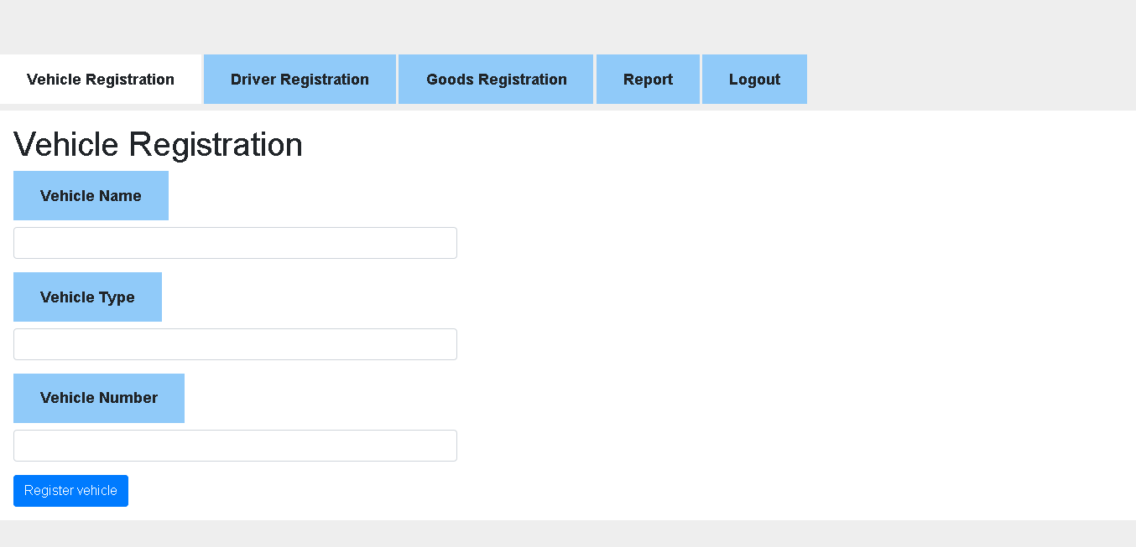

Slide 9
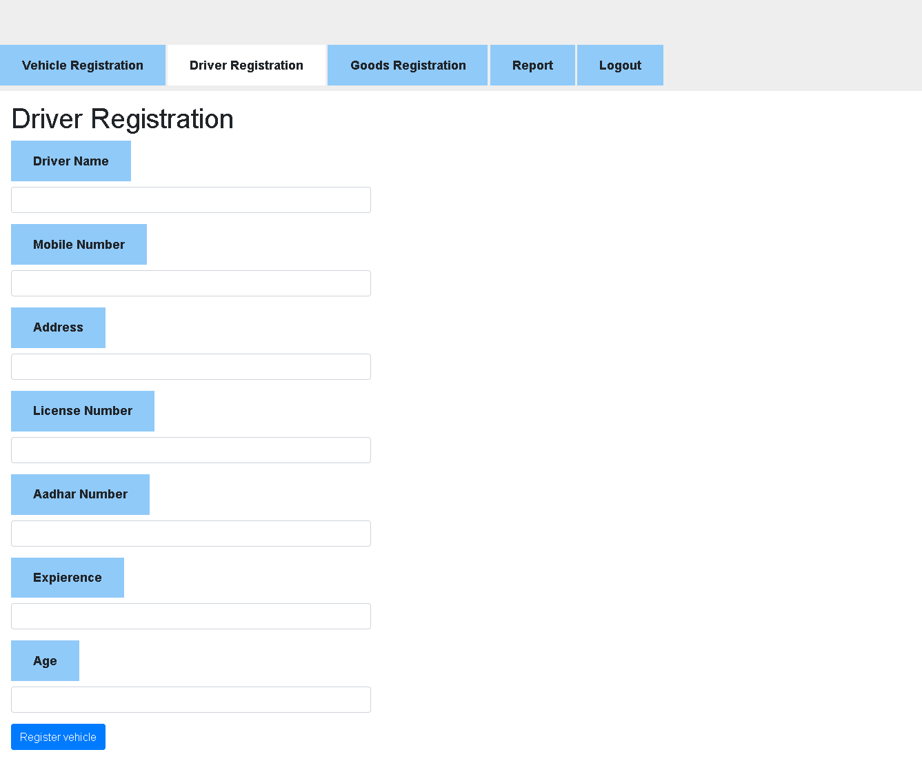

Slide 10
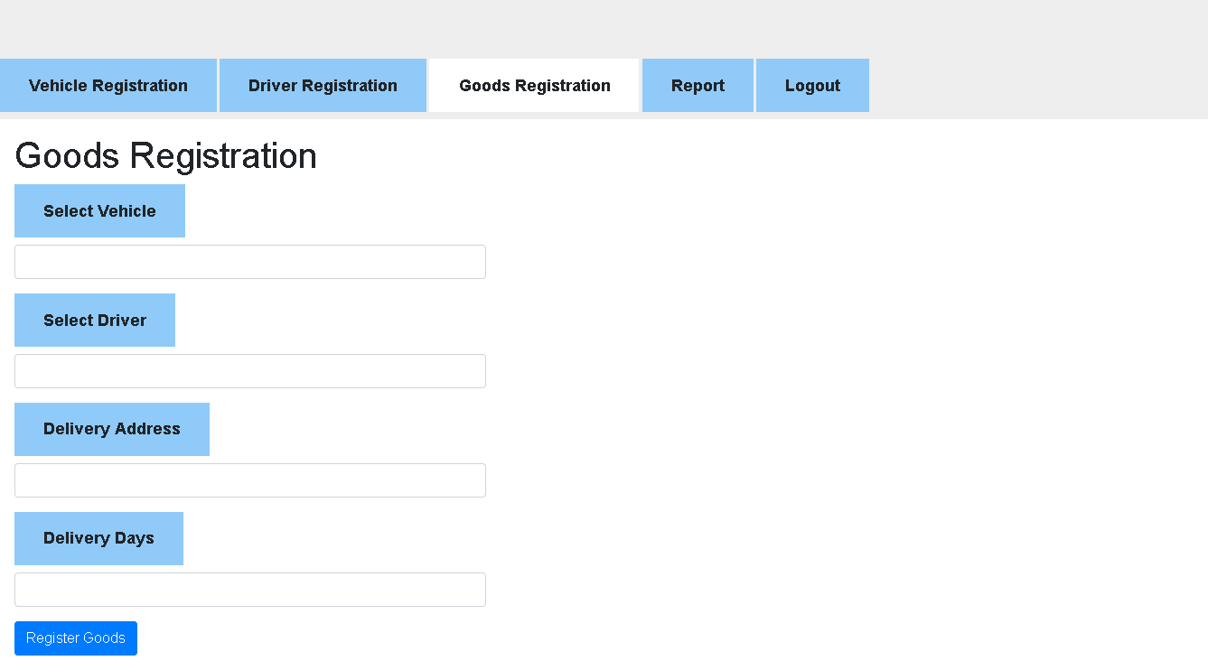

Slide 11
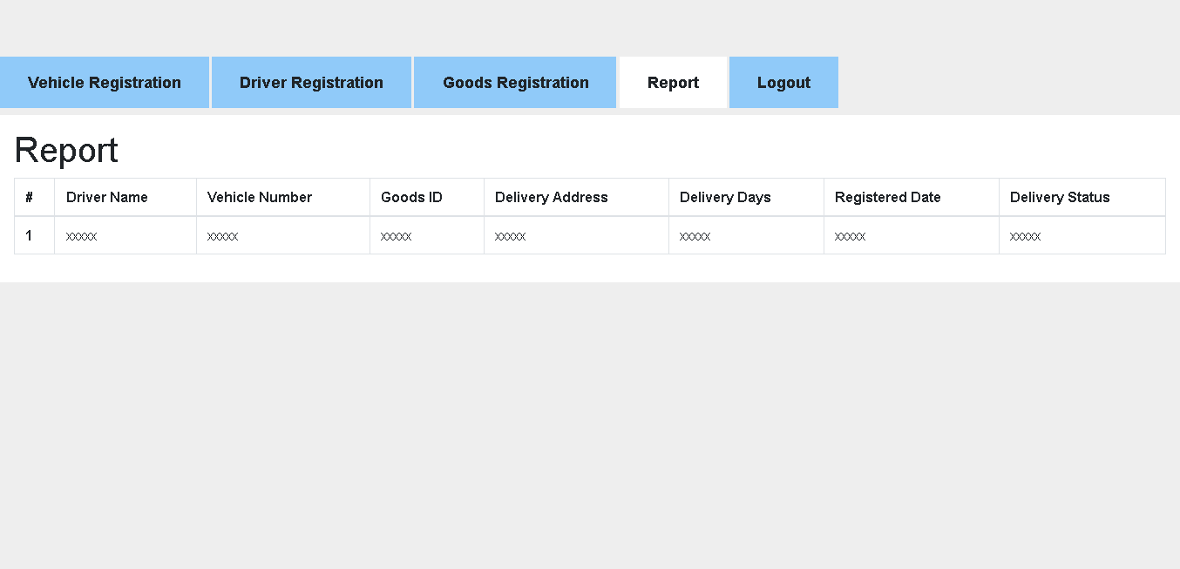

Slide 14
Thank You

